Slide 1


2022 Dec 15
DSCC 462 Final Project
Presented by:
Team 4 - Rishabh Kandoi, Ayush Singla, Aradhya Mathur, Richa Yadav
Notes:
Good Evening everyone! I am Richa and my team members are Aradhya, Rishabh and Ayush and today we are going to talk about our findings in the project assigned to us.

Slide 2

Problem Statement
Given historical data,
- Perform EDA to understand the relationship among variables and their impact on profit.
- Devise a strategy for higher profit likelihood by careful selection of attributes.
1
Notes:
I know everyone has received the same problem statement but still so that everyone is on the same page, let’s review the problem statement together
So we are given ad data from a company that wants to know how to advertise its products on social media in a better way.
Given historical data of ads, we have information like-
The social media platform led to the sale (socialmedia),
the age of the customer (age),
whether the customer was on mobile or a computer (mobile),
the season of the year when the sale took place (season),
whether or not the customer was a new customer (newcustomer),
the cost of the ad (adcost),
and the revenue generated by that customer (adrevenue).
Now the goal is to understand and interpret the relationships among variables discussed earlier and their eventual impact on profit.
The ultimate goal is to devise a strategy for profit maximization by careful selection of attributes that will guarantee the same.
Now let’s start with some EDA.

Slide 3
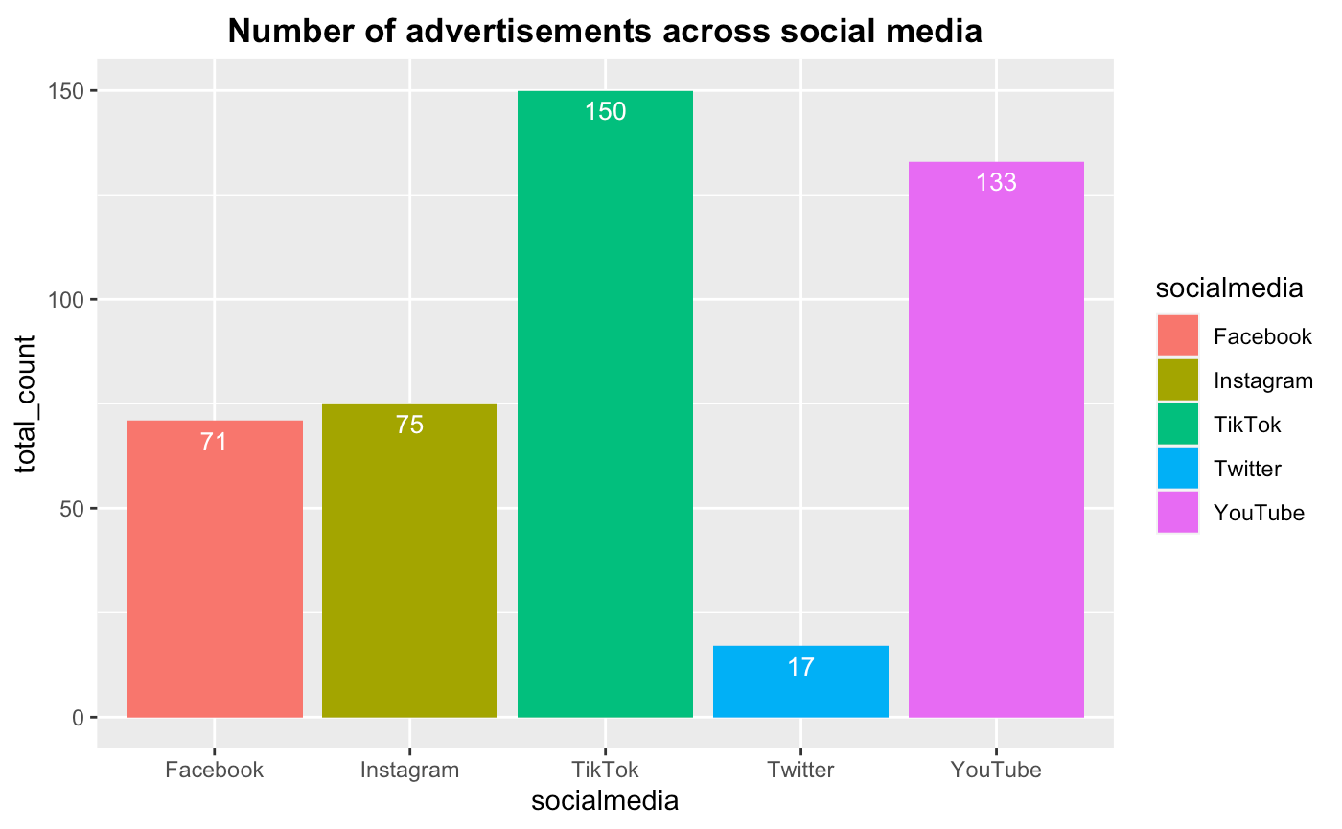


Comparison of platforms
TikTok and YouTube together account for 60% of the total Ads running across all platforms.
While Twitter accounts for just 4% of the entire distribution running across all platforms.
1
Notes:
60% of the total ads running

Slide 4
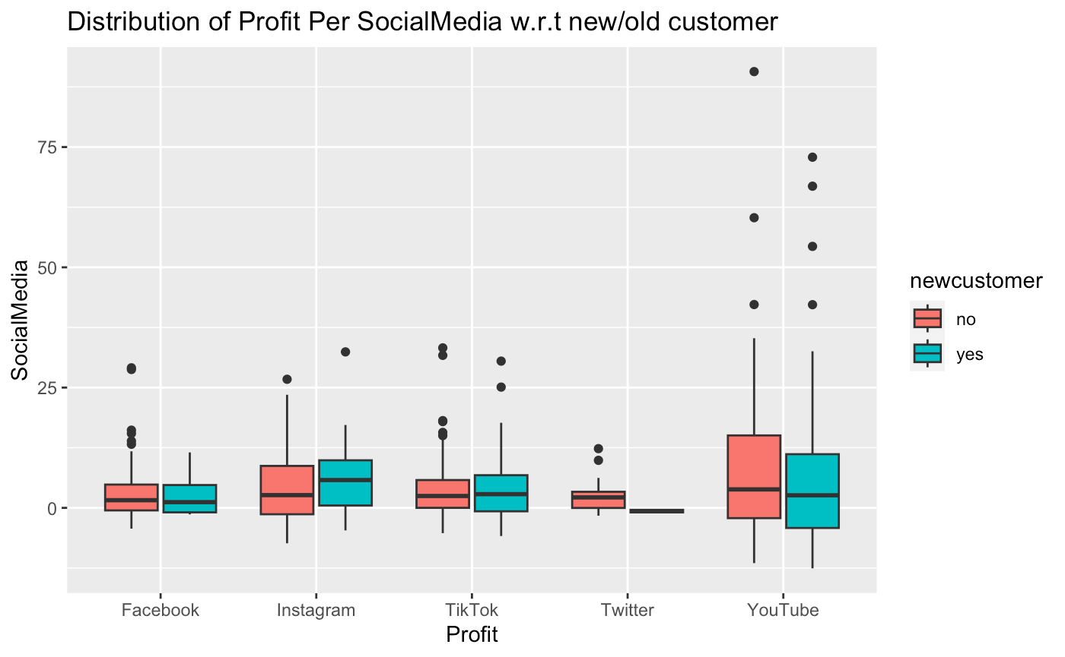
Profit across platforms w.r.t customer type
Clearly, YouTube records the highest profits across both new and old customers.
2
Notes:
1. This is the distribution of profit for new/old customers across all 5 platforms.
2. As seen in the last slide, although Instagram has 50% of the user base than TikTok, it actually provides more profit.
3. Youtube - Old customers gives more profit. Instagram - New customers provides more profit.
4. Twitter - Negative profit for new customer.
5. Facebook - 90% are old users.

Slide 5
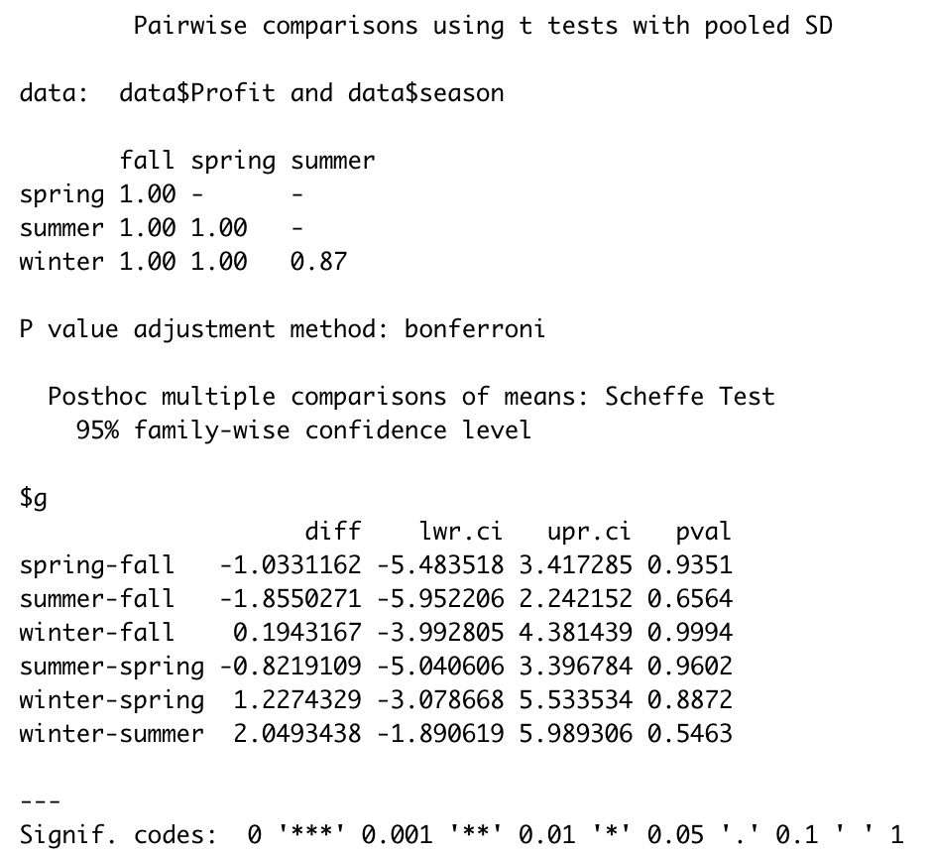
Impact of season on profit
According to the pairwise T-test using Bonferroni and Scheffe methods, All of the season pairs have equal average profit.
Thus, the choice of the season period doesn't significantly impact profit.
3

Slide 6
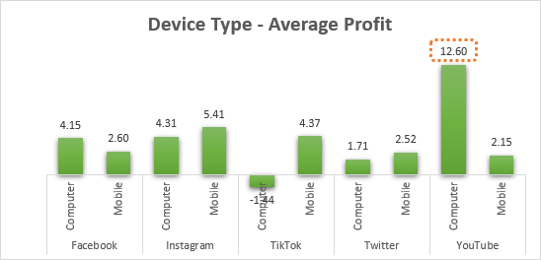
Overall average profit for Computer devices Is greater than for Mobilephones.
This is mostly driven by YouTube users (16%) generating maximum profit i.e. 12.6.
For our use case, given an investment, there is no control in the selection of device type for the target user.
Impact of device type on profit
4

Slide 7
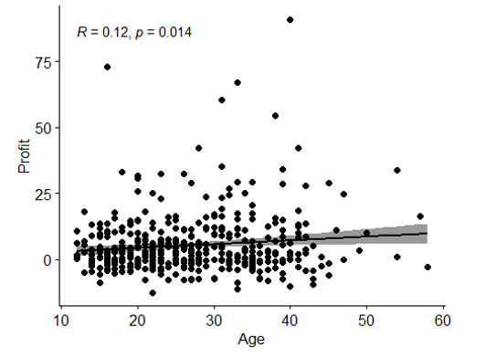
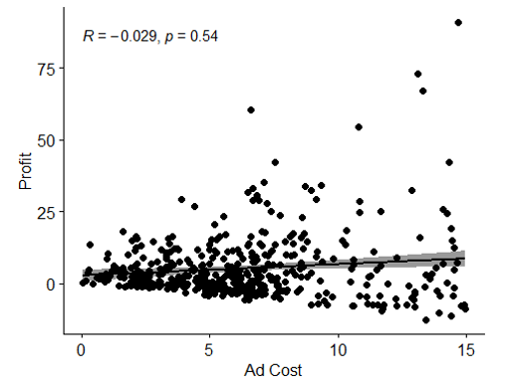
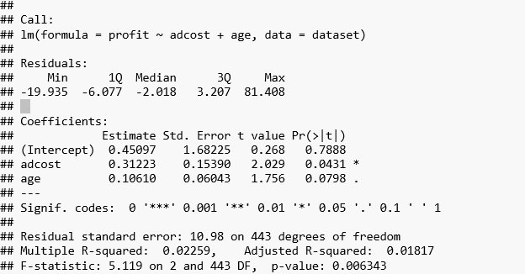
Impact of age and Ad cost on profit
The correlation between Age Vs. Profit and Ad Cost Vs. Profit are insignificant.
According to the linear regression analysis shown beside, neither Ad cost nor Ad cost + age impact profit.
5

Slide 8
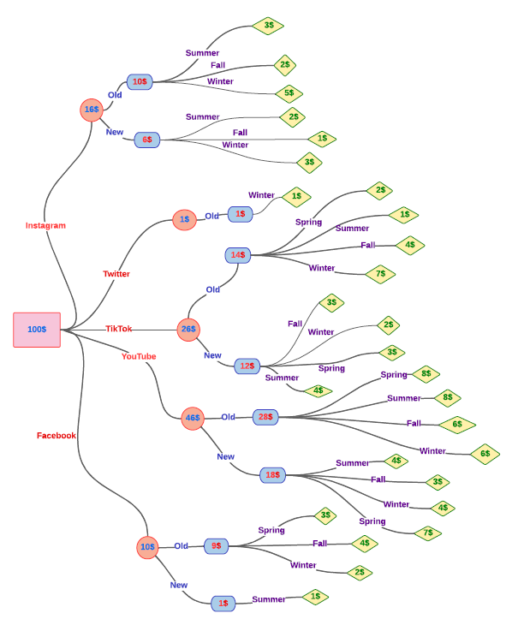
Cost Distribution
To conclude, we recommend investing more in YouTube and TikTok, especially focusing on existing customer engagement.
6
Notes:
To devise a more profitable marketing strategy, we will focus more on Youtube and TikTok to maximize profits.

